Slide 1


DQN
March 16, 2019
CONTACT
Chunggi Lee

Slide 2

1
목차
DQN
DQN DEMO

Slide 3
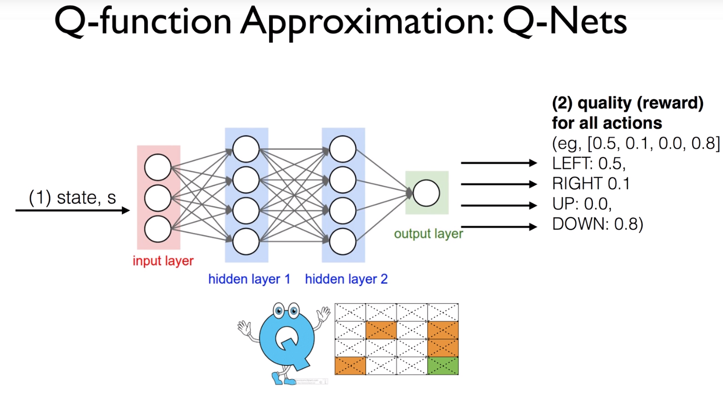
1
DQN
Neural Network → Approximate
- Need lots of storage space
- Not available in Real Application

Slide 4
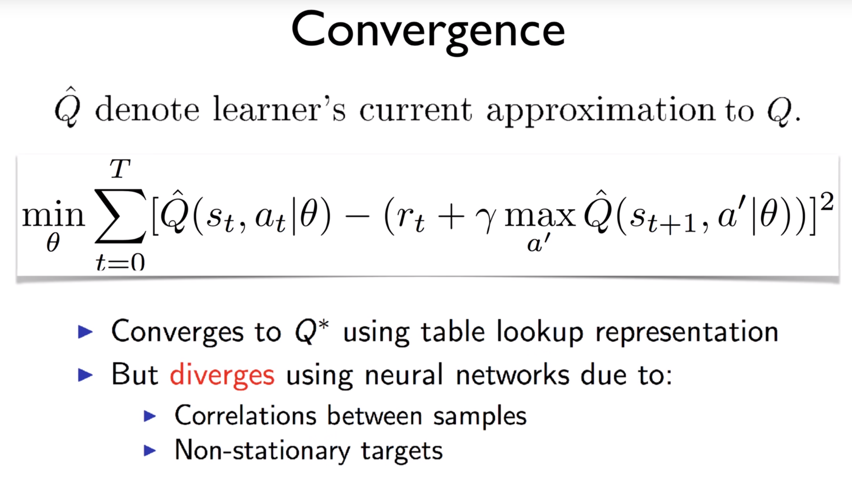
1
Diverges : 학습이 잘 안된다!
DQN

Slide 5
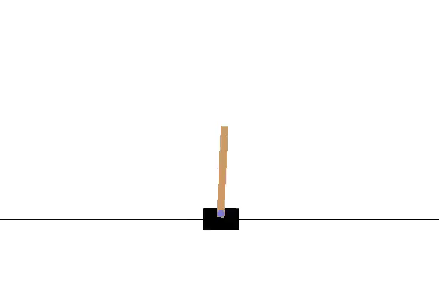
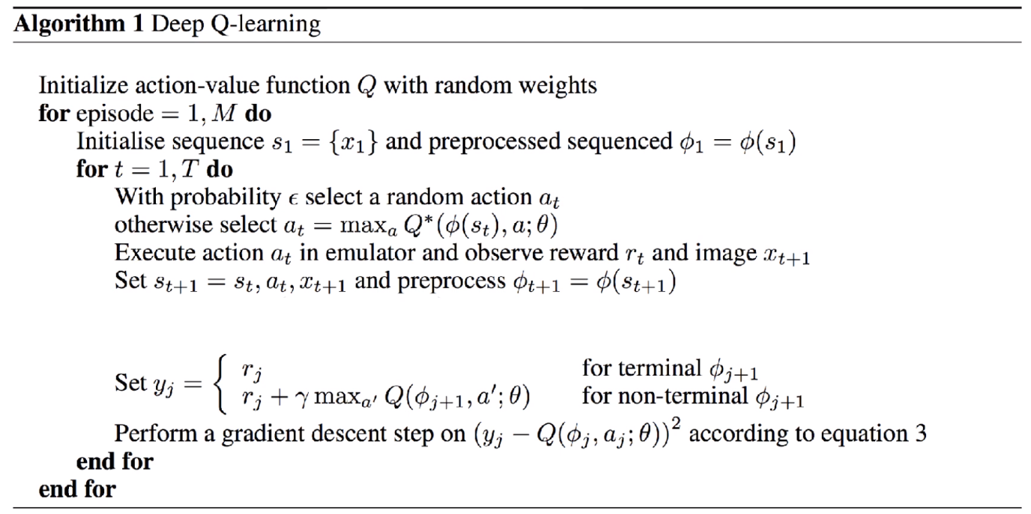
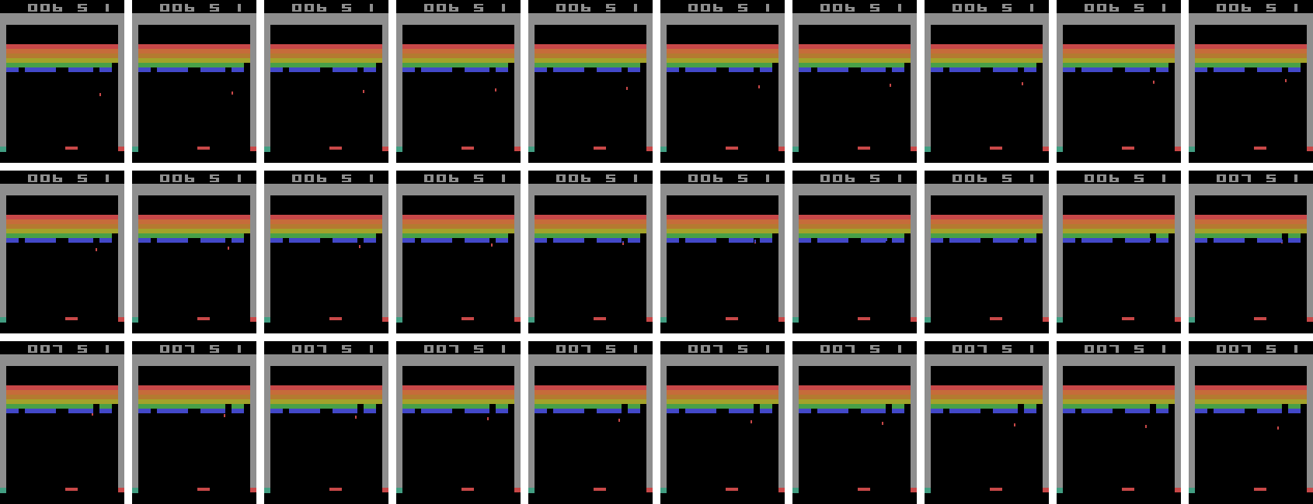
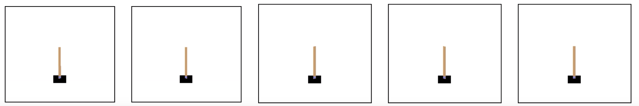
1
Correlations Between Samples
환경이 조금씩 바뀌니까 →받아오는 Data들이 굉장히 유사함
Sample들이 연관성이 많다.

Slide 6
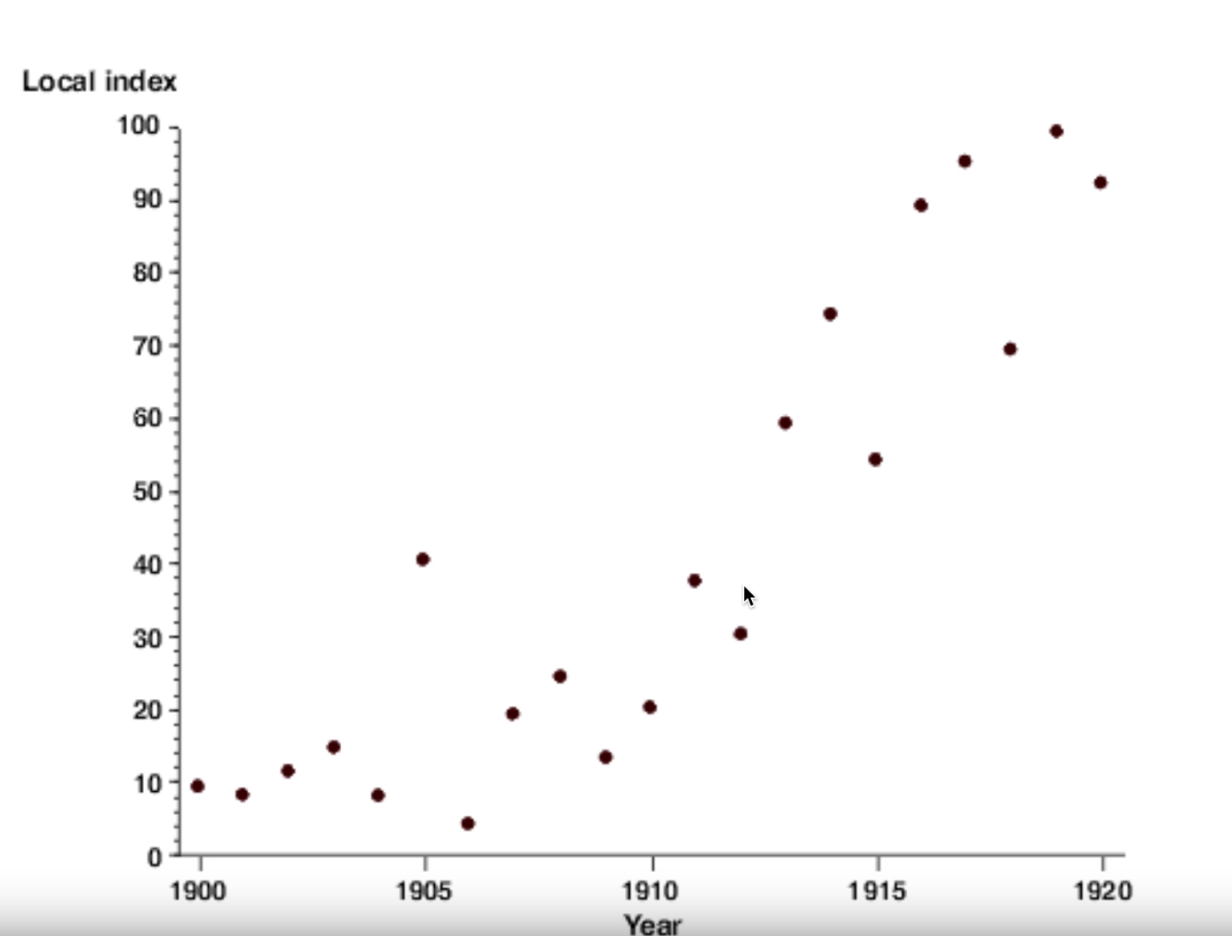
1
Correlations Between Samples

Slide 7
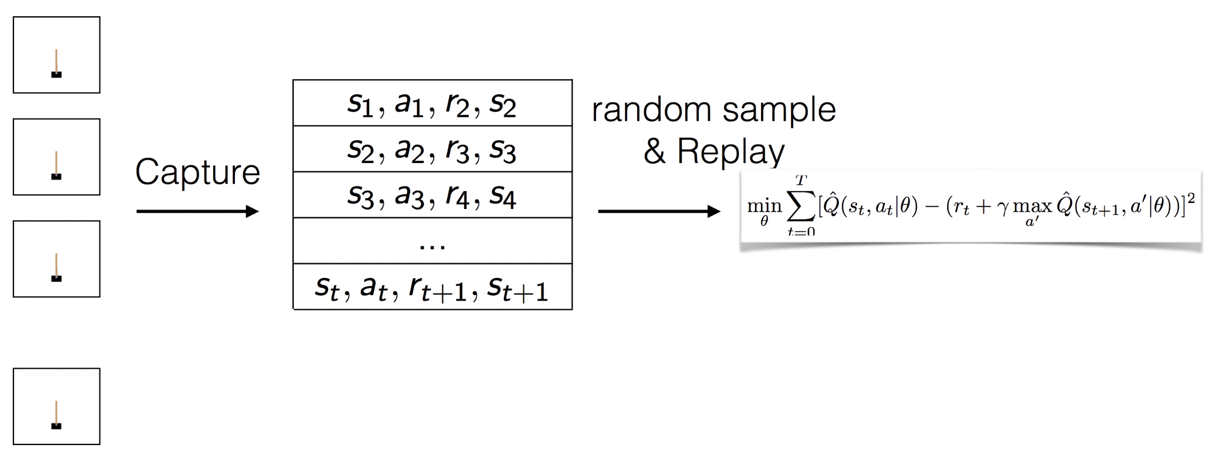
1
Solution : Experience Replay
Buffer (D)

Slide 8
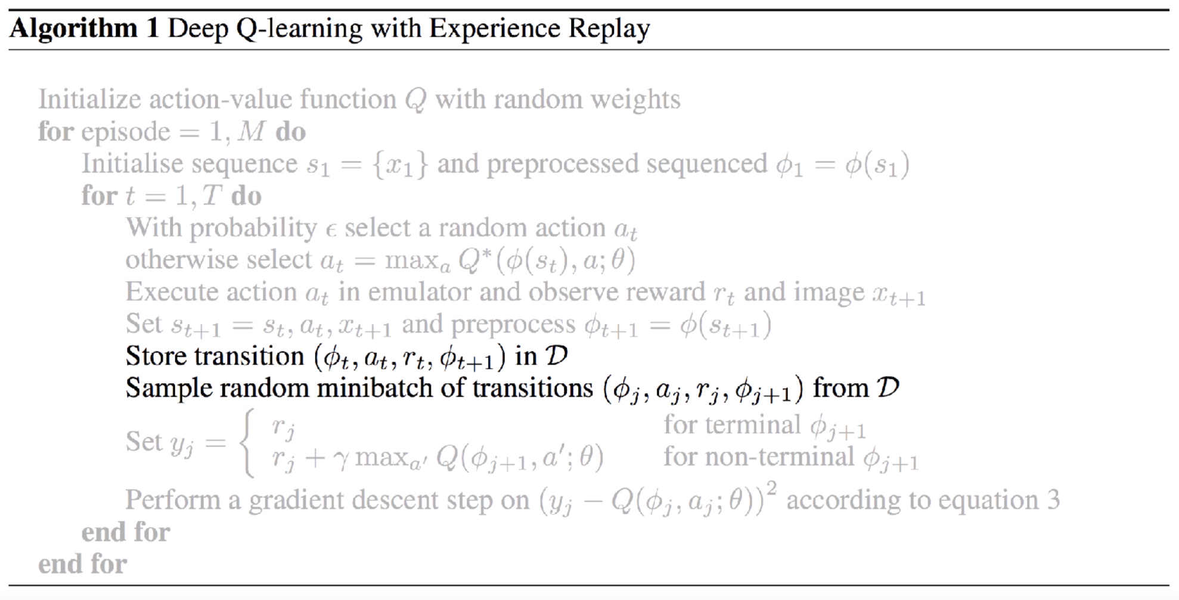
1
Solution : Experience Replay
Buffer
Dataset에서 조금씩 뽑아서 사용

Slide 9
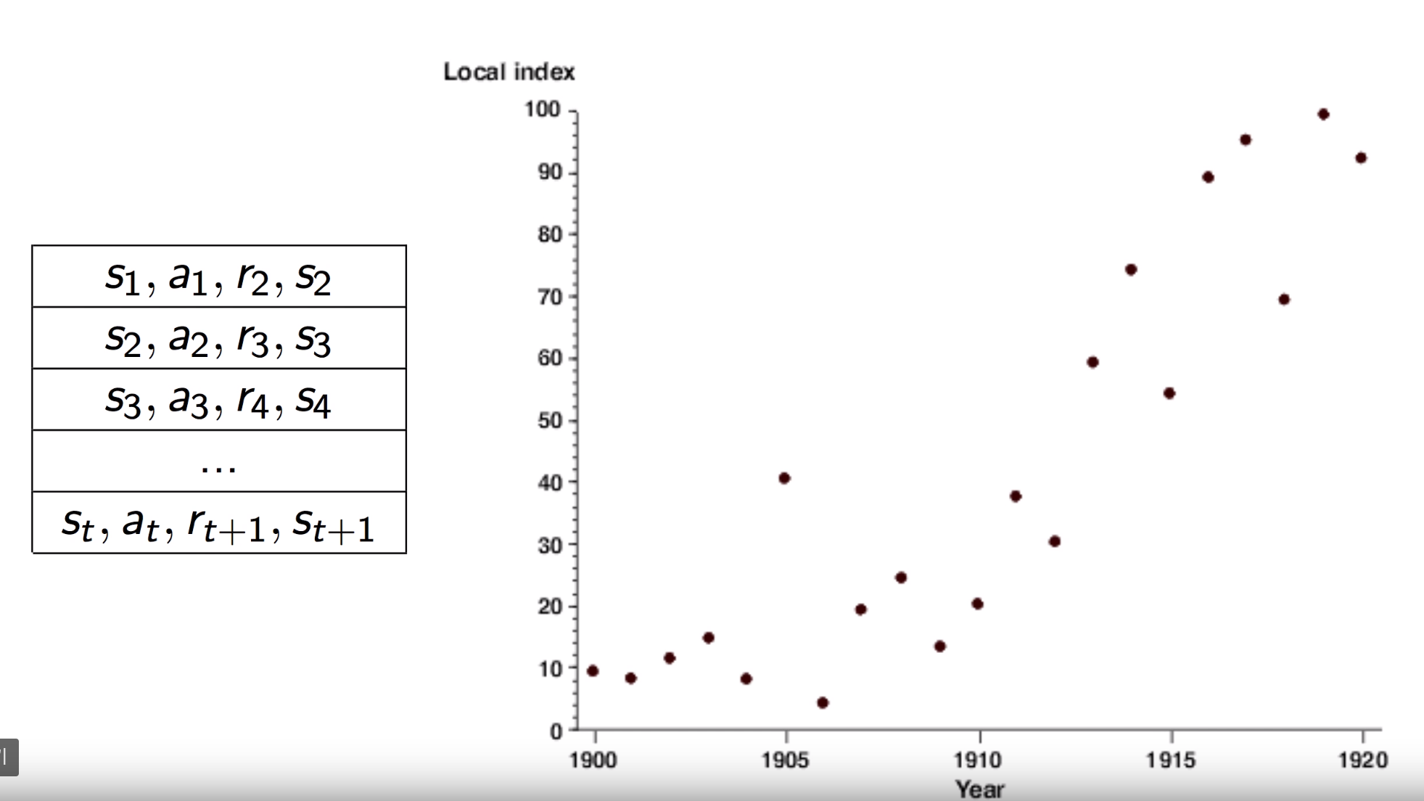
1
Solution : Experience Replay

Slide 10
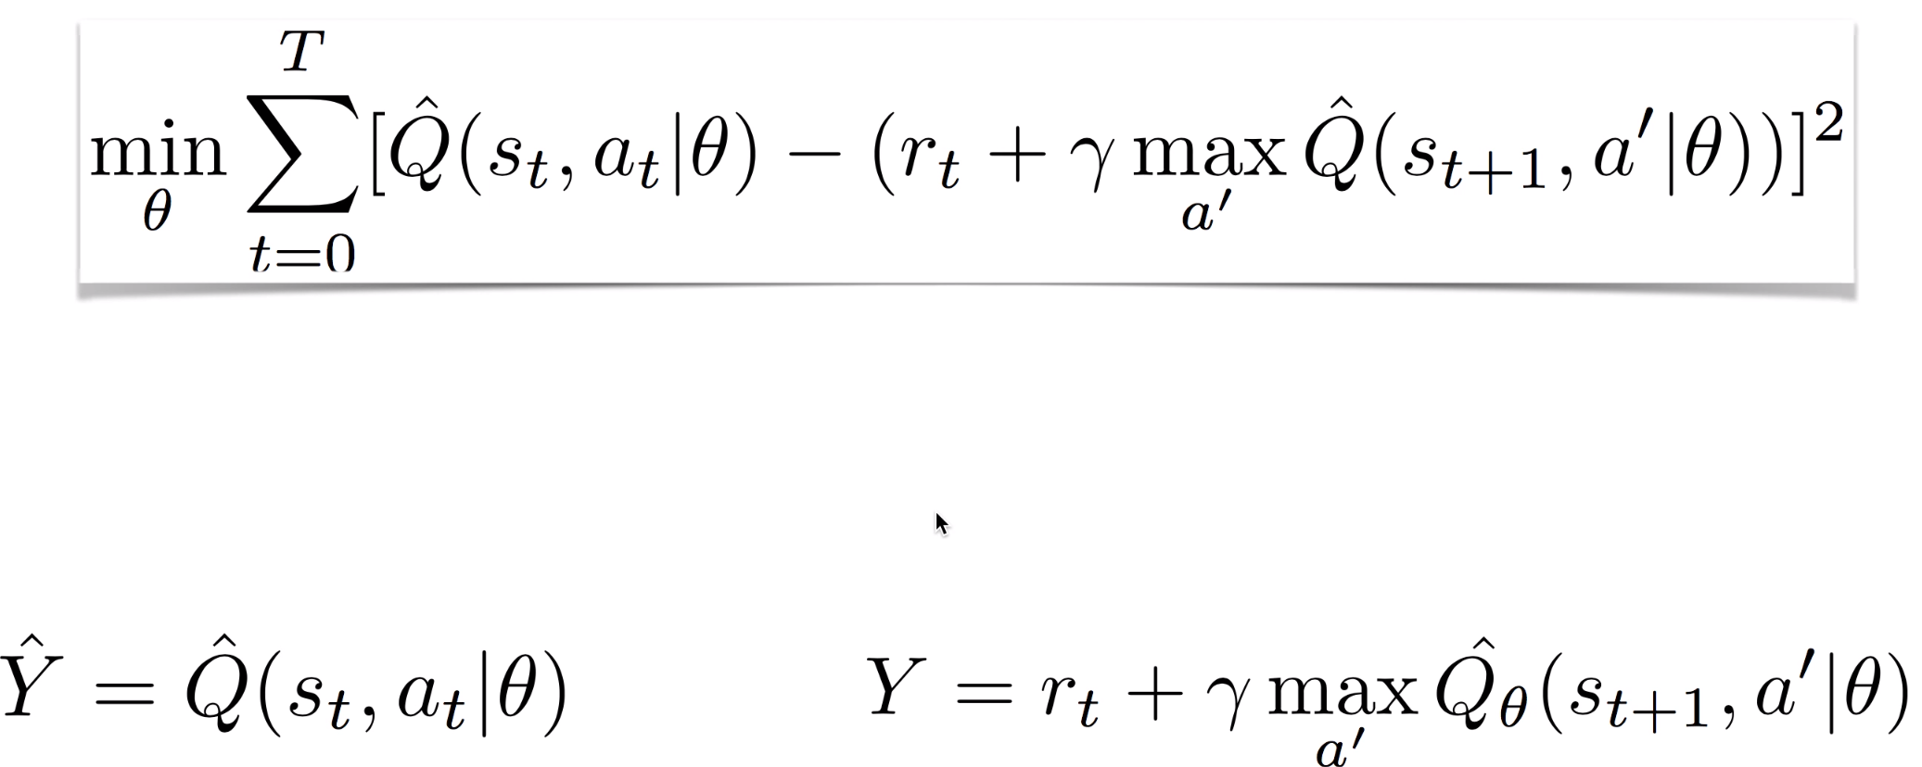
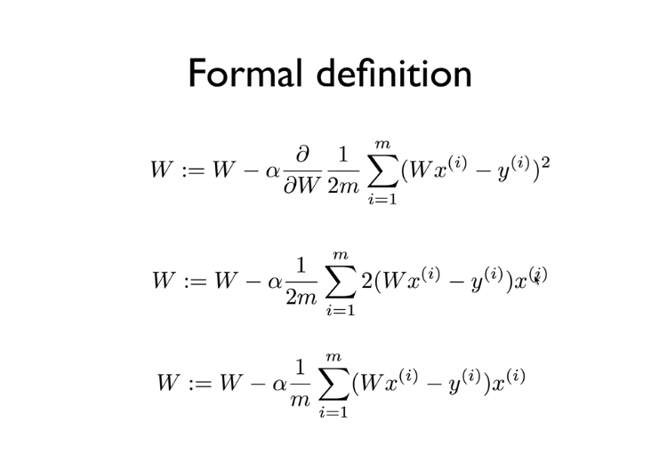
1
Non-Stationary Target

Slide 11
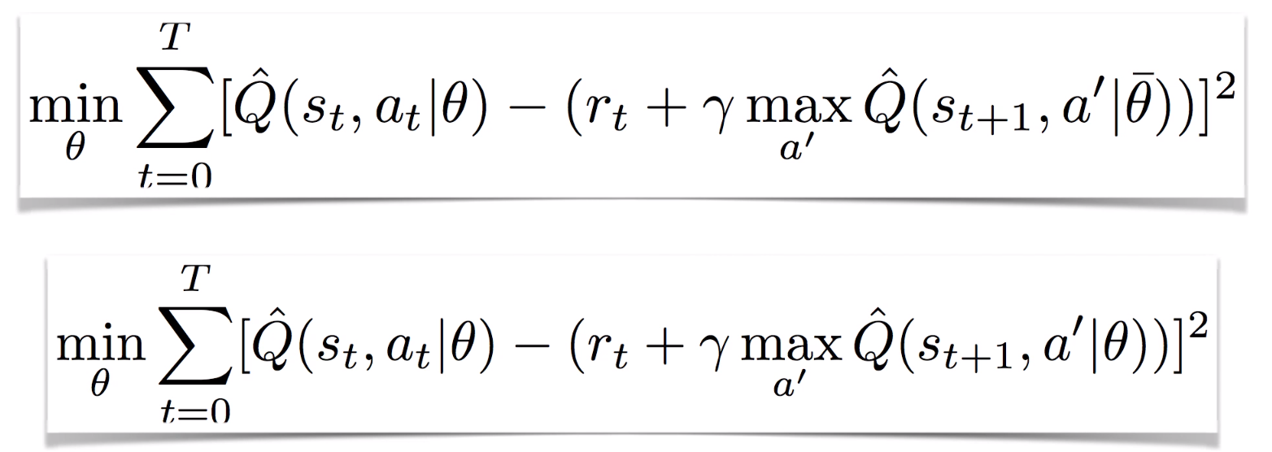
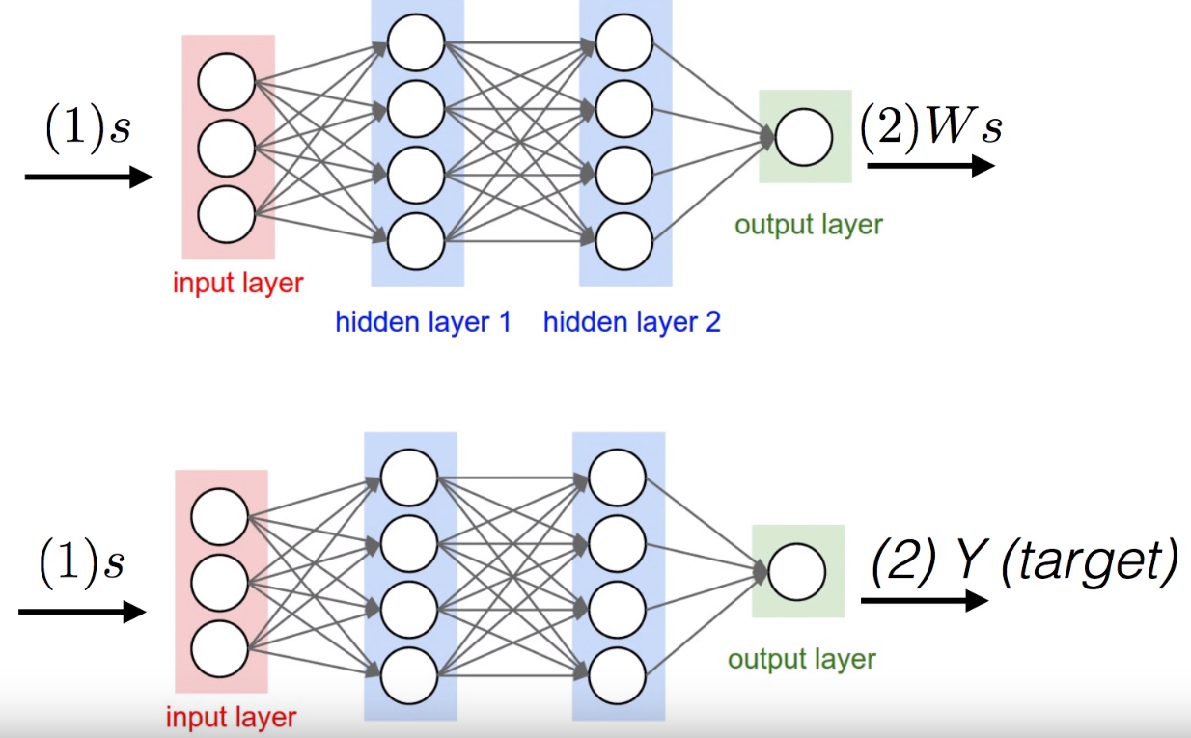
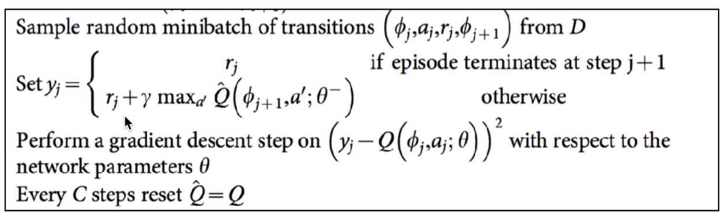
1
Solution : Copy Network

Slide 12
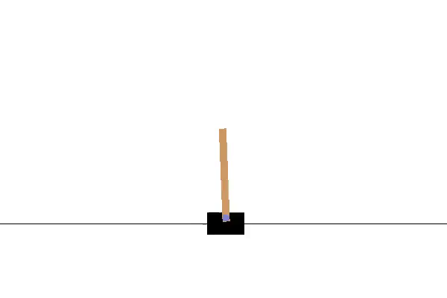
1
DQN DEMO
Before Training
After Training

Slide 13
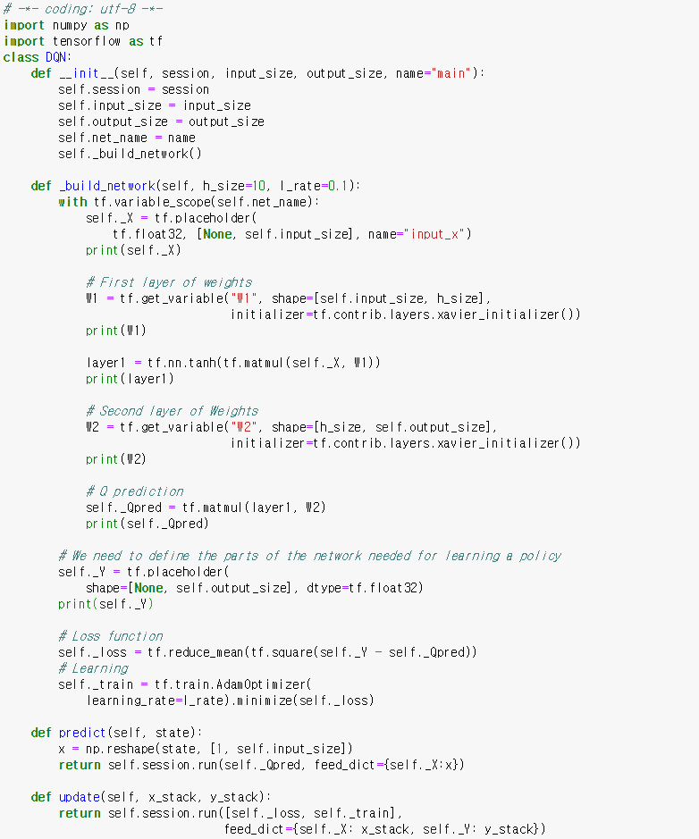
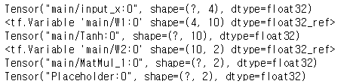
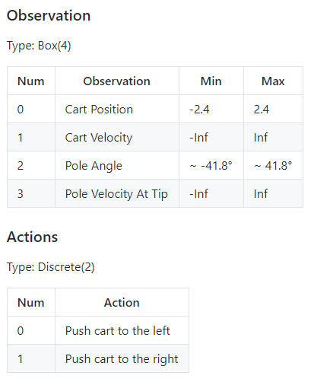
1
DQN DEMO – Correlation with Samples

Slide 14
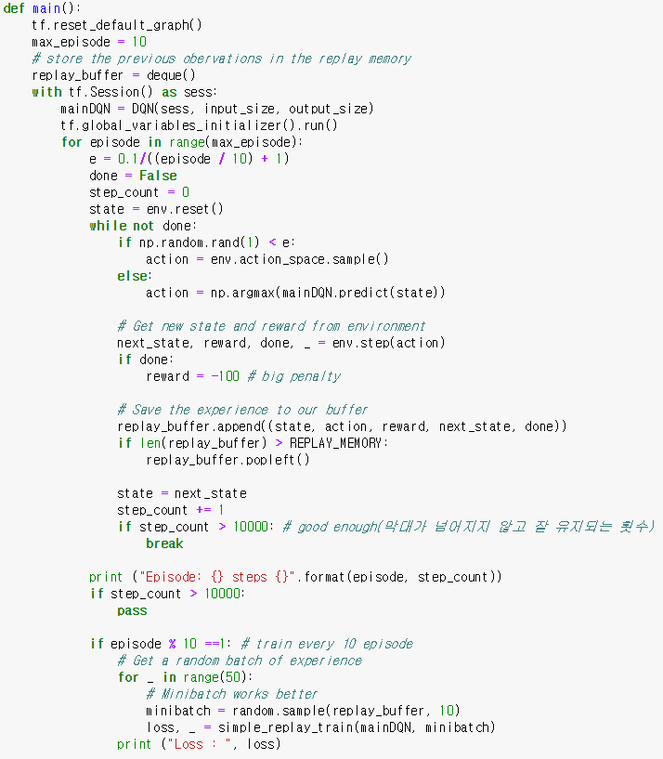
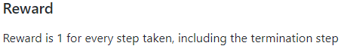
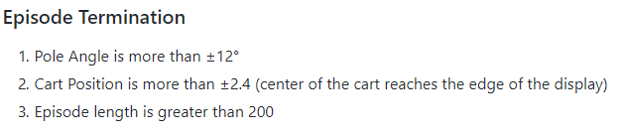
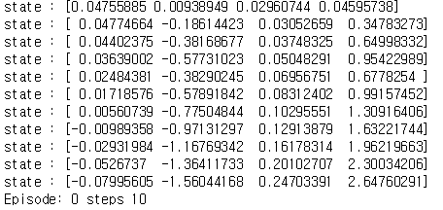
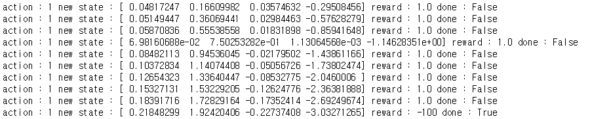
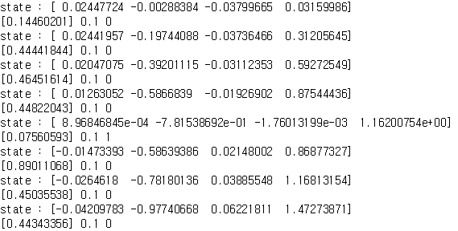
1
DQN DEMO – Correlation with Samples
1
3
2

Slide 15
1
DQN DEMO – Correlation with Samples

Slide 16
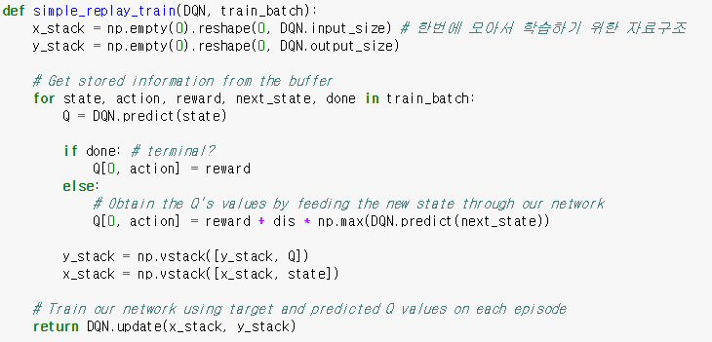
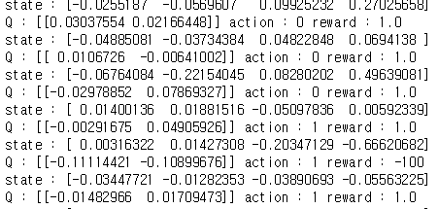
1
DQN DEMO – Correlation with Samples

Slide 17
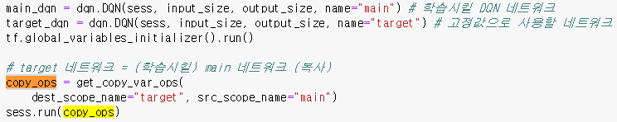
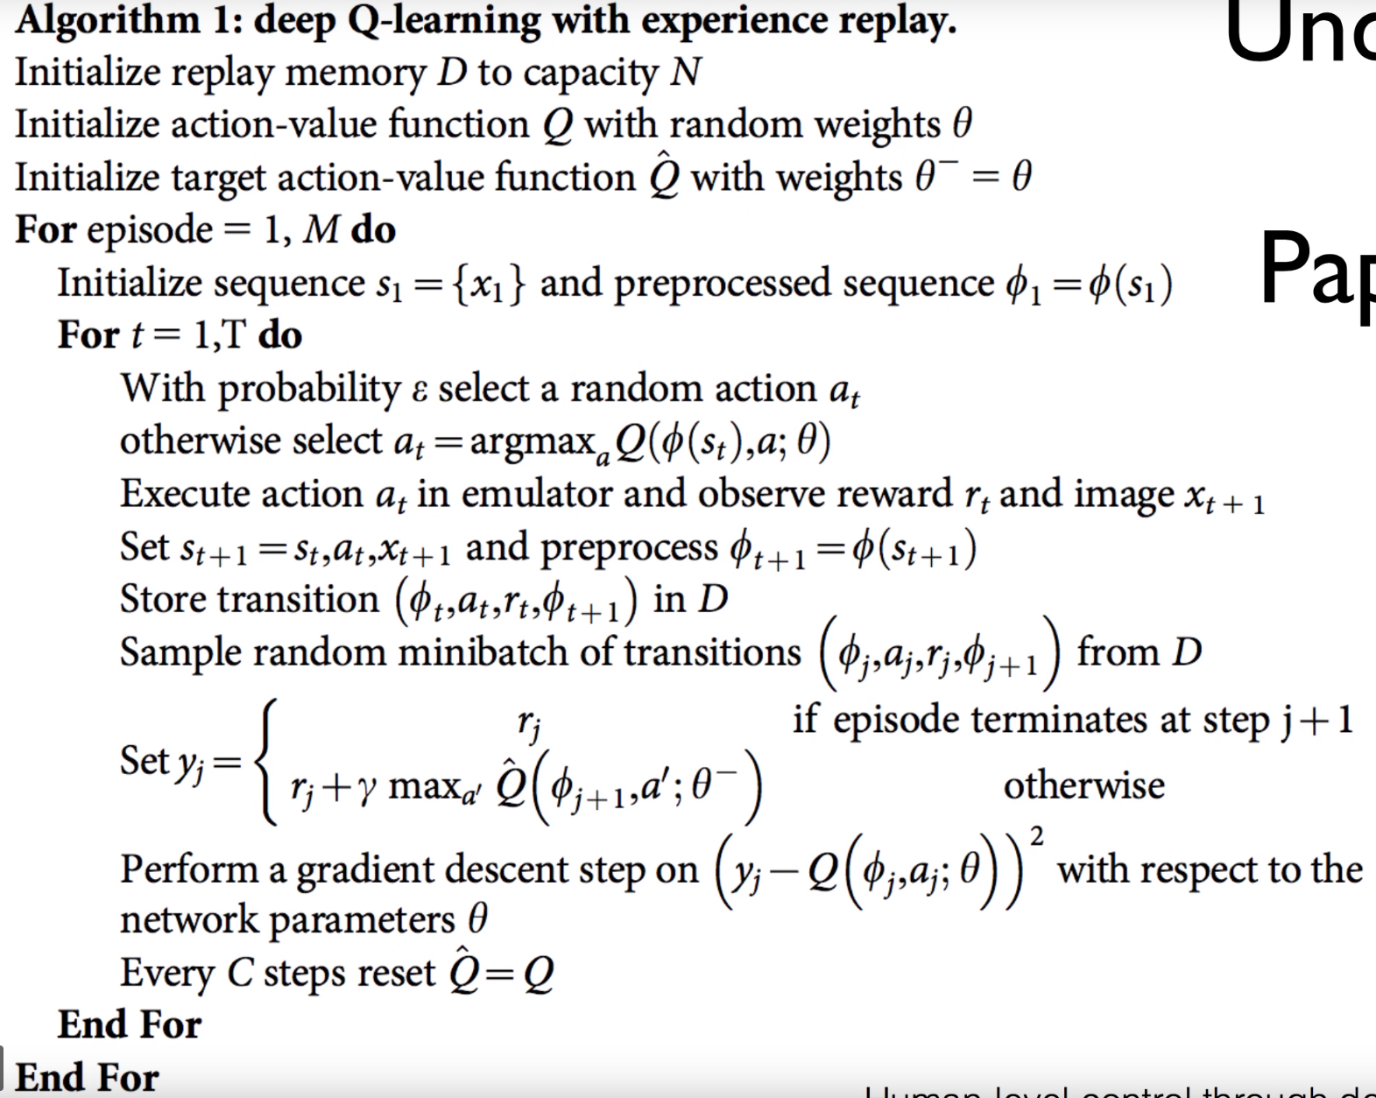
1
DQN DEMO – Non-stationary Target

Slide 18
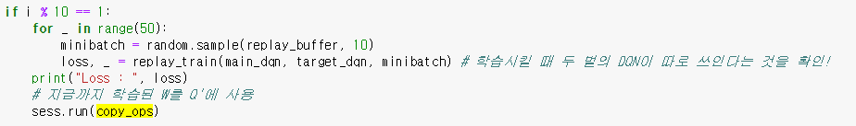
1
DQN DEMO – Non-stationary Target

